Slide 1
Doubly Linked Lists

Slide 2
Doubly Linked List
Doubly Linked List Overview
Header and Trailer Sentinels

Slide 3
Doubly Linked List
In a doubly linked list, we define a linked list in which each node keeps an explicit reference to the node before it and a reference to the node after it.
These lists allow a greater variety of O(1)-time update operations, including insertions and deletions.
We continue to use the term “next” for the reference to the node that follows another.
We have a new term “prev” for the reference to the node that precedes it.

Slide 4
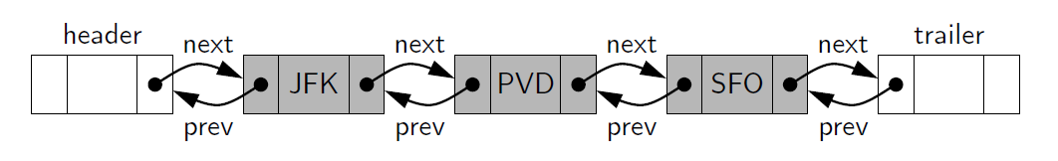
Sentinel Node
We add special nodes at both ends of the list.
a header node at the beginning of the list
a trailer node at the end of the list.
These “dummy” nodes are known as sentinels (or guards)

Slide 5
Inserting and Deleting with a Doubly Linked List
Every insertion into our doubly linked list representation will take place between a pair of existing nodes
When a new element is inserted at the front of the sequence, we will simply add the new node between the header and the node that is currently after the header.

Slide 6
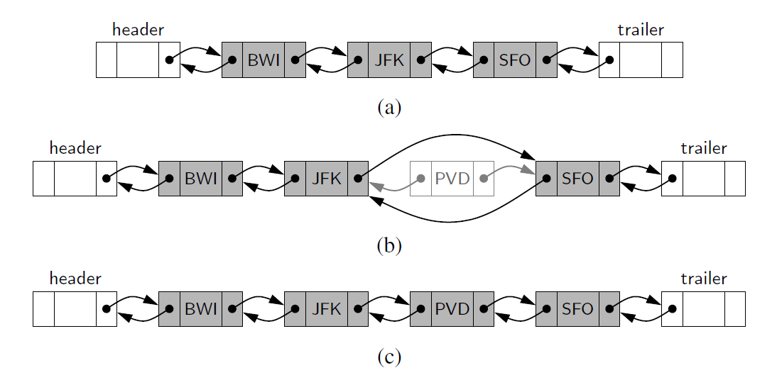
Inserting and Deleting with a Doubly Linked List

Slide 7
Inserting and Deleting with a Doubly Linked List
(a) before the operation
(b) after creating the new node
(c) after linking the neighbors to the new node

Slide 8
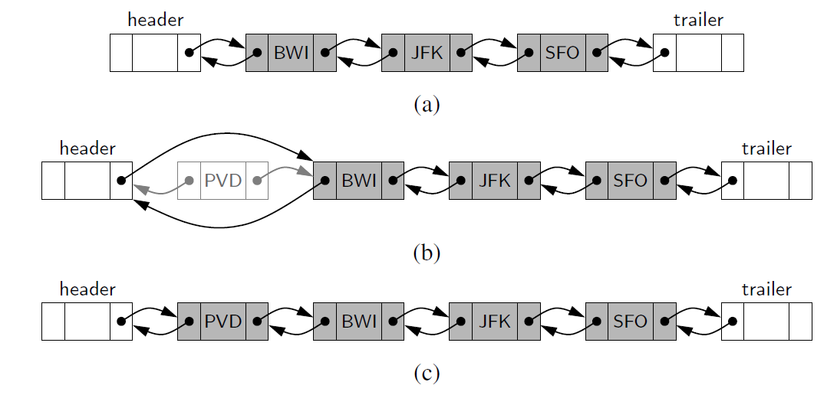
Insertion of a Node to Front

Slide 9
Insertion of a Node to Front
(a) before the operation
(b) after creating the new node
(c) after linking the neighbors to the new node

Slide 10
Deletion of a Node
The two neighbors of the node to be deleted are linked directly to each other
As a result, that node will no longer be considered part of the list and it can be reclaimed by the system.
Because of sentinels, the same implementation can be used when deleting the first or the last element of a sequence.

Slide 11
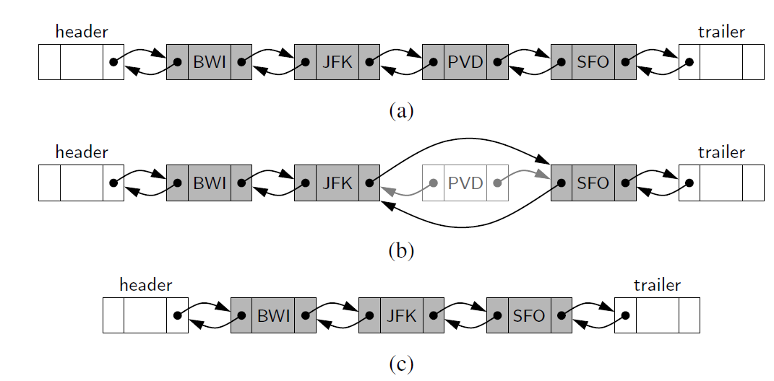
Deletion of a Node

Slide 12
Deletion of a Node
(a) before the removal
(b) after linking out the old node
(c) after the removal

Slide 13
Review
Learned about Doubly Linked List Nodes
Insertion
Deletion
Up next, implementation of a Doubly Linked List!

